Slide 1
ICFM Webinar No. 3 “Lowering Risk by Increasing Resilience”
Slobodan P. Simonović
Chairperson of the ICFM Ad Hoc Committee
Western University
Institute for Catastrophic Loss Reduction
London, Ontario, Canada

Slide 2
Brief history of ICFM
The 1st International Symposium on Flood Defence, September 20-23, 2000 Kassel, Germany
River Flood Defence
The 2nd International Symposium on Flood Defence, September 10-13, 2002 Beijing, China
Flood Defence 2002
The 3rd International Symposium on Flood Defence, May 25-27, 2005 Nijmegen, Nederland
Floods, from Defence to Management
The 4th International Symposium on Flood Defence, May 6-8, 2008 Toronto, Canada
Managing Flood Risk, Reliability & Vulnerability
The 5th International Conference on Flood Management, September 27-29, 2011 Tokyo, Japan
Floods: From Risk to Opportunity
The 6th International Conference on Flood Management, September 16-18, 2014 São Paulo, Brazil
Floods in a Changing Environment
The 7th International Conference on Flood Management, September 15-17, 2017 Leeds, UK
Resilience to Global Changes- Anticipating the Unexpected
The 8th International Conference on Flood Management, August 9 – 11, 2021 Iowa City, USA
Lowering Risk by Increasing Resilience

Slide 3
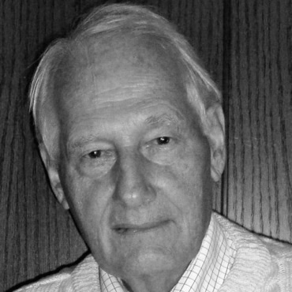
Prof. Erich J. PLATE
In memoriam: Prof. Erich Plate (1929-2019)
ICFM vision: “International Conference on Flood Management (ICFM) offers an international conference platform, hosted every 3 years, to discuss a range of flood related issues and provides a unique opportunity for various specialists including engineers, planners, natural and social scientists, health specialists, disaster managers, decision makers, and policy makers to come together to exchange ideas and experiences.”
Notes:
Professor Erich Plate, the founding father of the International Conference on Flood Management (ICFM) series, passed away on July 22, 2019. He was a visionary scientist, a tireless innovator in hydrologic engineering, and a professional community leader. He has brought unique contributions to flood risk management from basic theory to various applications.

Slide 4
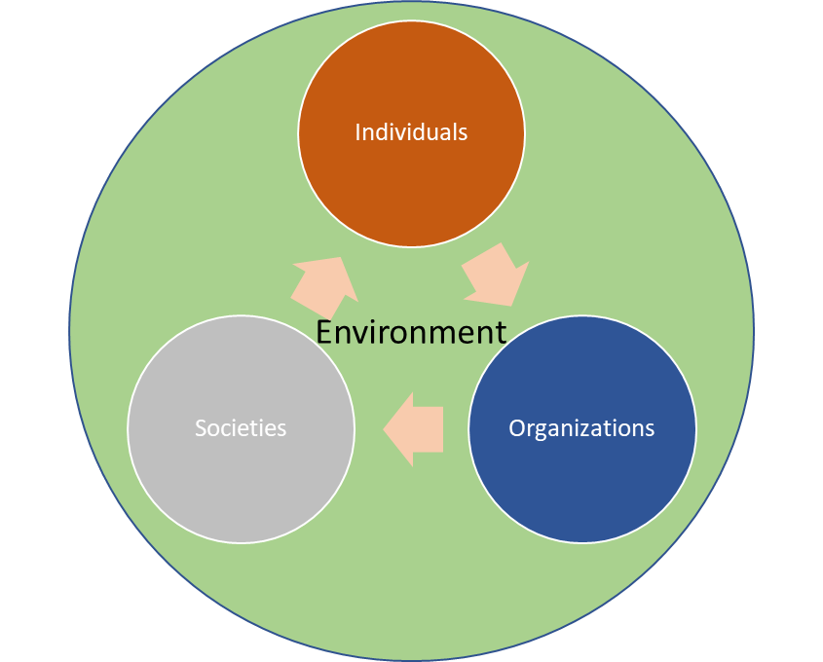
ICFM principles
Interdisciplinarity
Independence
Partnership (science and practice)
Scales - international, regional, national and local
Supporters – UNESCO, WMO and ICLR

Slide 5
ICFM activities
Ad Hoc Committee – everyone is welcome
Support - ICFM permanent secretariat – IWHR Beijing, China
Conference
Local Organizing Committee
Lifetime Achievement Award
Erich Plate Best Young Scientist Poster Award
Website www.icfm.world
Webinars www.icfm.world/Webinars

Slide 6
Webinar No. 3

